Slide 1
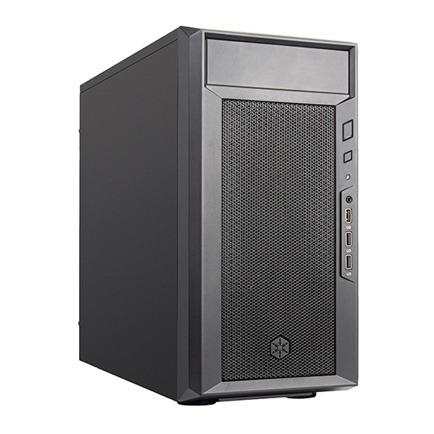
On-Prem AI Workstation
XAI-748D / XAI-772D | Micro-ATX Desktop x NVIDIA RTX PRO 5000 Blackwell 48GB / 72GB
RTX
PRO
Deploy AI Agents, knowledge-base Q&A, computer vision, and enterprise workflow automation directly inside the customer environment.
Data Local
CUDA Stack
48/72GB ECC VRAM
Customer Briefing Deck | 2026-06-17

Slide 2
Why Consider On-Prem AI Now?
Not every AI workload belongs in the cloud, especially when data control, response time, and long-term cost matter.
Data Privacy
Low Latency
Cost Control
• Customer data, internal documents, and video records do not need to be sent to external services.
• Cameras, device signals, and voice interactions can be processed locally in real time.
• For high-frequency use, hardware depreciation is easier to forecast than long-term token/API fees.
Operational Continuity
Custom Integration
Controlled Upgrades
• Core workflows can keep running internally when networks are unstable or policies restrict cloud use.
• Connect to MES, ERP, NAS, PLCs, cameras, and internal databases.
• Adjust GPU, SSD, memory, networking, and maintenance plans as needs evolve.
Sources: NVIDIA / AMD / Apple official specifications, accessed 2026-06-17

Slide 3
What Can On-Prem AI Do?
From office knowledge work to field sensor data, on-prem AI brings models closer to where the data lives.
AI Agent
Knowledge-Base Q&A
1
2
Automatically retrieve data, generate reports, organize email, and call internal systems.
RAG Q&A over catalogs, SOPs, maintenance records, and quotation data.
Computer Vision
OpenClaw Agent
3
4
Production defect inspection, safety monitoring, license-plate, traffic, and object detection.
An always-on local agent that executes tools, skills, and cross-system workflows through messaging channels.
Engineering Design
Security & Compliance
5
6
CAD, rendering, simulation assistance, design-data search, and document generation.
Summarize and audit internal documents while keeping sensitive data inside the company.
Use cases are planning examples; actual scope depends on data sources, models, and integration requirements.

Slide 4
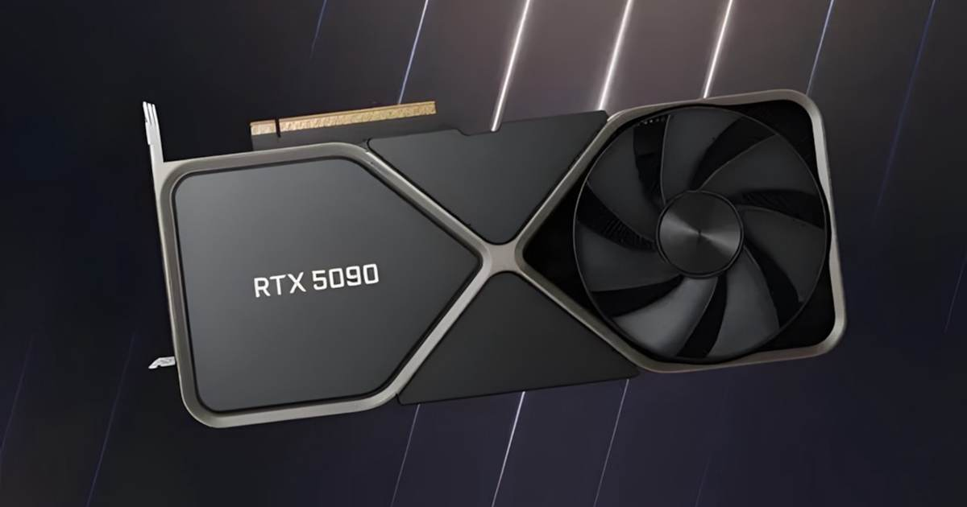
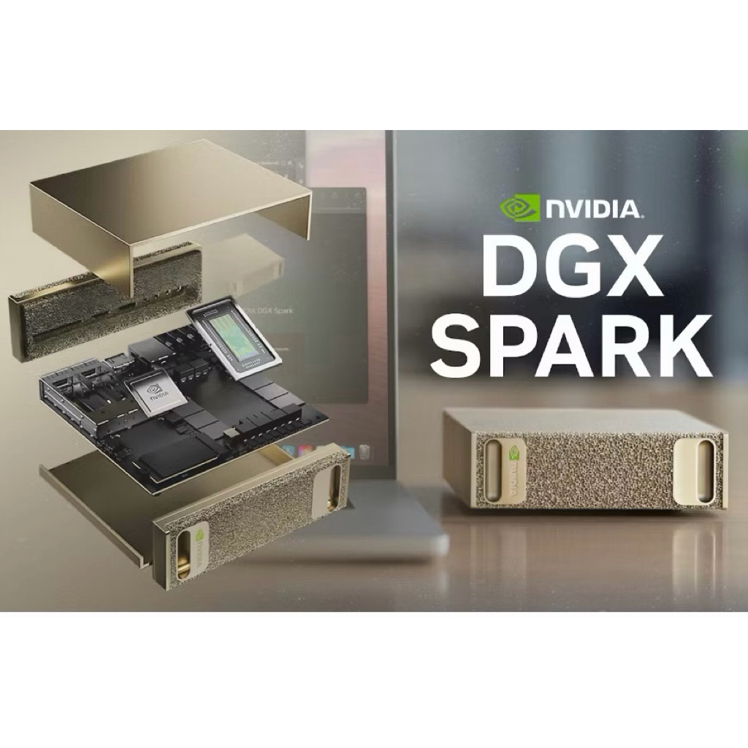
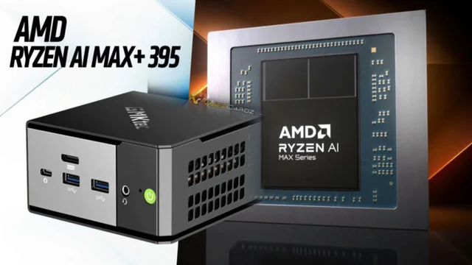
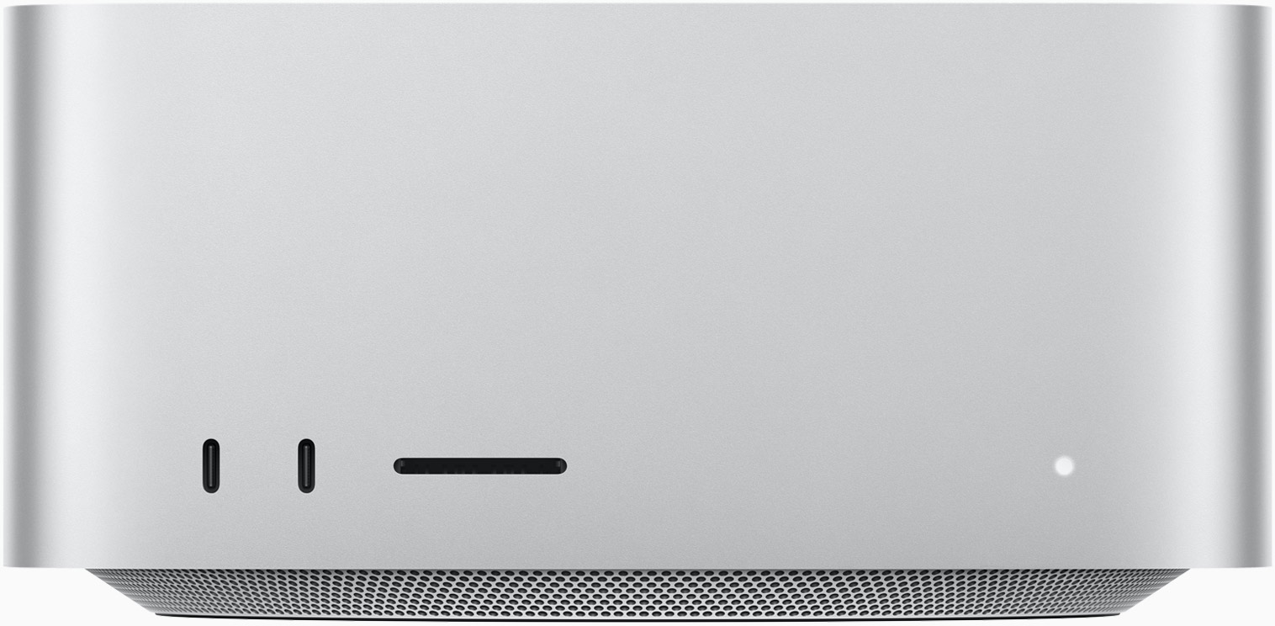
Common On-Prem AI Product Paths
Market options include GPU PCs, AI appliances, APU mini PCs, Mac workstations, and professional GPU workstations.
RTX 5090 PC
NVIDIA DGX Spark
Ryzen AI Max+ 395
Mac Studio
XAI-748D / XAI-772D
High-performance GeForce desktop
32GB GDDR7 for entry development, creation, and inference
Compact AI appliance
128GB unified memory, DGX OS, and NVIDIA AI stack
APU / mini desktop path
128GB LPDDR5x, integrated Radeon 8060S, and NPU
macOS ecosystem workstation
M4 Max / M3 Ultra; quiet, compact, and highly integrated
Micro-ATX pro GPU workstation
48/72GB ECC VRAM; serviceable and customizable
Sources: NVIDIA / AMD / Apple official specifications, accessed 2026-06-17

Slide 5
Pros and Cons of Alternative Options
Each product has its place; key differences are VRAM, software ecosystem, serviceability, and deployment flexibility.
RTX 5090 PC
DGX Spark
Pros
+ Strong single-GPU compute
+ Easy component sourcing
+ Attractive price/performance
Limits
- 32GB VRAM tight for large models
- Consumer GPU, weaker commercial support
- Thermals/power need planning
Pros
+ Compact and low power
+ Integrated NVIDIA AI stack
+ Suitable for large-model prototyping
Limits
- DGX OS appliance is less flexible
- Limited expansion/serviceability
- Not ideal for custom PCIe or I/O
Ryzen AI Max+ 395
Mac Studio
Pros
+ 128GB unified memory
+ Windows/Linux flexibility
+ Compact and low power
Limits
- Incomplete CUDA ecosystem
- iGPU differs from pro GPU inference
- CUDA migration cost
Pros
+ Compact, quiet, and stable
+ High memory bandwidth
+ Strong fit for macOS creative workflows
Limits
- No CUDA support
- Hardware is not upgradeable
- Enterprise GPU container limits
Sources: NVIDIA / AMD / Apple official specifications, accessed 2026-06-17

Slide 6
XAI-748D / XAI-772D: Micro-ATX RTX PRO AI Workstation
XAI-748D / XAI-772D: Micro-ATX RTX PRO AI Workstation
XAI-748D pairs with a 48GB GPU; XAI-772D pairs with a 72GB GPU for production on-prem AI deployment.
XAI-748D = 48GB GPU; XAI-772D = 72GB GPU, positioned for production on-prem AI deployment.
48 / 72GB
300W
mATX
GDDR7 ECC VRAM
GPU Max Power
Serviceable Desktop Platform
RTX PRO 5000 Specification Highlights
• 14,080 CUDA cores; 5th-gen Tensor Cores; 4th-gen RT Cores
• 2,064 AI TOPS; 65 TFLOPS FP32; 196 TFLOPS RT Core
• 48/72GB GDDR7 ECC, 512-bit, 1,344GB/s memory bandwidth
• PCIe 5.0 x16, 3x NVENC / 3x NVDEC, 4x DisplayPort 2.1b
• MIG: 48GB can split into 2x24GB; 72GB can split into 2x36GB
Source: NVIDIA RTX PRO 5000 Blackwell datasheet; final configurations can be adjusted by customer needs.

Slide 7
XAI-748D / XAI-772D: Strengths and Constraints
Presenting both strengths and conditions up front makes the proposal easier for customers to trust.
Key Strengths
Items to Confirm
• 48GB / 72GB ECC VRAM is better suited than RTX 5090 32GB for large models and long-context inference
• 1,344GB/s memory bandwidth is critical for local LLM token generation speed
• System power under 600W, with manageable thermals and fan noise
• Mature CUDA and NVIDIA ecosystem for open models, RAG, agents, and vision AI toolchains
• Micro-ATX platform is easier to expand with SSDs, memory, NICs, and field I/O than small appliances
• Desktop serviceability simplifies warranty, parts replacement, and custom integration
• Thermals, noise, and power delivery must be planned around the GPU, CPU, chassis, and PSU
• If customers only run small models or use AI lightly, an entry PC or cloud service may be cheaper
• Multi-user services need permissions, backup, monitoring, and model operations workflows
• If the target workflow is macOS-only creative work, Mac Studio remains comfortable
• Cost is slightly higher than other options
Sources: NVIDIA / AMD / Apple official specifications, accessed 2026-06-17

Slide 8
Overall Comparison
Evaluated from an SMB / field deployment perspective, not as a pure benchmark ranking.
Solution
AI Memory
CUDA
Perf.
Power
Memory BW
Field Int.
Best Fit
Main Limits
XAI-748D /
XAI-772D
48/72GB
ECC VRAM
Strong
XAI-772D
70B Q4 ~28 tok/s
GPU 300W
System <600W
1,344
GB/s
High
Enterprise/
Factory/Lab AI
Plan thermals,
supply, power
RTX 5090 PC
32GB
GDDR7
Strong
2.3 tok/s
70B Q4 offload
GPU 600W
System 900W+
1,792
GB/s
Medium
Dev/creation
small inference
70B Q4 needs offload
weaker commercial support
DGX Spark
128GB
unified
Strong
Non-Q4 ref.
70B ~4.67 tok/s
PSU 240W
GB10 140W
273
GB/s
Medium
AI prototype
agent dev
Limited Q4 data
lower I/O flexibility
Ryzen AI
Max+ 395
128GB
unified
Weak/Med
Non-Q4 ref.
70B ~4.97 tok/s
cTDP
45-120W
~256
GB/s
Medium
Low-power
small AI PC
Limited Q4 data
CUDA gap
Mac Studio
96GB
unified
None
13.1 tok/s
70B 4-bit MLX
System max
480W
819
GB/s
Medium
macOS
creation/dev
Not GGUF Q4
hard to upgrade
Note: DGX Spark and Ryzen AI Max+ 395 figures found are 70B FP8/FP16 reports, not Q4.
Key point: XAI-748D / XAI-772D provides 1,344GB/s bandwidth and 48/72GB ECC VRAM; bandwidth directly affects LLM decode-stage token generation speed.
Sources: RTX PRO 5000 datasheet, NVIDIA/AMD/Apple official specs, arXiv 2605.00519, PC Gamer / Bijan Bowen reports.

Slide 9
How Should Customers Choose?
Choose by use case, not by spec sheets alone.
Customer Scenario
Recommended Option
Reason
Internal documents, RAG, and AI agents; data must stay inside, with meaningful model capacity
XAI-748D / XAI-772D
Mature CUDA toolchain, internal-system integration, and serviceability
OpenClaw / AI Agent workflows that need local persistence and data control
XAI-748D / XAI-772D
Runs models, tools, and skills on-prem; suitable for enterprise automation
Research teams prototyping quickly with the NVIDIA AI stack
DGX Spark ／XAI-748D / XAI-772D
Compact, highly integrated, and suitable for model experiments
Individual development or budget-sensitive users running small to medium models
RTX 5090 PC
Strong compute and price/performance; commercial support needs evaluation
macOS creators or Apple ecosystem workflows
Mac Studio
Quiet and compact, with strong creative-app integration
Sources: NVIDIA / AMD / Apple official specifications, accessed 2026-06-17

Slide 10
Conclusion
On-prem AI does not replace cloud
1
It keeps sensitive data, real-time needs, and field-system integration inside the enterprise.
Customers need deployable solutions
2
Hardware, models, data, permissions, backup, and operations must be designed together.
Clear product positioning
3
XAI-748D / XAI-772D combines RTX PRO 5000 48/72GB with a serviceable Micro-ATX platform for professional GPU capability, ecosystem fit, and field flexibility.
Recommended next step: Build 2-3 standard configurations for target customers, such as entry inference, 72GB large-model, and field vision AI editions.

Slide 11
Sources
Deck specifications are based mainly on official product pages; unverified prices and non-fixed lead times are avoided.
Source Summary
• NVIDIA RTX PRO 5000 datasheet: 14,080 CUDA, 2,064 AI TOPS, 48/72GB GDDR7 ECC, 1,344GB/s, 300W, MIG
• NVIDIA GeForce RTX 5090: 32GB GDDR7, 512-bit, approx. 1,792GB/s, CUDA cores, AI TOPS, system preparation information
• NVIDIA DGX Spark: GB10 Grace Blackwell, 128GB unified memory, 1 PFLOP FP4, DGX OS
• AMD Ryzen AI Max+ 395: 16C/32T, 128GB LPDDR5x-8000, 256-bit, approx. 256GB/s, Radeon 8060S, 126 TOPS overall
• Apple Mac Studio Specs: M4 Max / M3 Ultra, M3 Ultra 96GB unified memory, 819GB/s, Thunderbolt 5
• arXiv 2605.00519: RTX 5090 70B Q4_K_M offload 2.3 tok/s; M3 Ultra 70B 4-bit MLX 13.1 tok/s
• PC Gamer / Bijan Bowen: DGX Spark and Strix Halo 70B measured approx. 4.67 / 4.97 tok/s, but FP8/FP16, not Q4
Note: Price, availability, actual model capacity, and performance vary by channel, driver version, quantization method, context length, and system thermal design.

